Slide 1
Software Engineering
Lesson – UML: 1 Use Case Diagrams

Slide 2
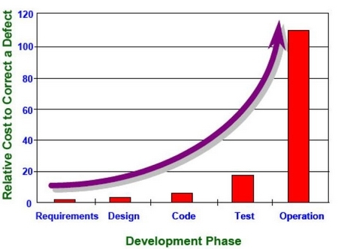
Importance of Requirements
Requirements Gathering is the MOST critical stage of the whole SDLC
If done wrong, can lead to a project failure at a later stage

Slide 3
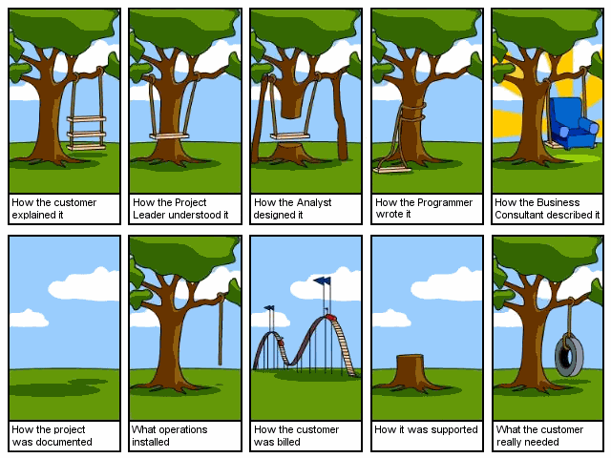
The Mismatch

Slide 4

Reasons for gathering incorrect requirements
Client does not know exactly what he wants or how to express himself
Client constantly changing his mind during the whole project
System Analyst has week communication skills
Using technical jargon
Not having enough knowledge of the problem domain

Slide 5
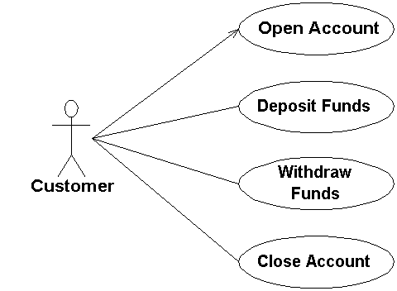
What is Use Case Diagram?
A diagram that shows the relationships among actors and use cases within a system.
Use case
holds functional requirement in an easy-to-read, easy-to-track text format
Use case is a goal statement plus scenarios (use case succeeds or fails). Use cases nest inside each other
Use case diagrams are often used to:
Provide an overview of all or part of the usage requirements for a system or organization in the form of an essential model or a business model
Communicate the scope of a development project

Slide 6
Use Cases – WHY to use?
The users are usually not able to produce sufficient formal descriptions of the functionalities.
A simple list of the required functionalities is not good enough.
The informal general description by the users hardly does the job, either.
The users may be able to describe by examples how they would want to use the system or how they perform certain tasks

Slide 7
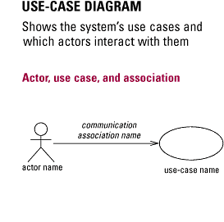
Use Case Diagram Notations

Slide 8
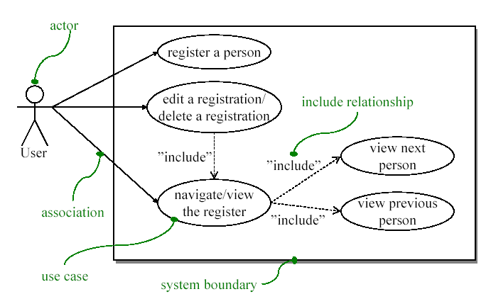
USE CASE Diagram

Slide 9
Use Case Diagram Notation
System Boundary: Sets the boundary of the system in relation to the actors who use it (outside the system) and the features it must provide (inside the system).
Actor: A role played by a person, system, or device that has a stake in the successful operation of the system.
Use Case: Identifies a key feature of the system. Without these features, the system will not fulfill the user/actor requirements. Each Use Case expresses a goal that the system must achieve.
Association: Identifies an interaction between actors and Use Cases. Each association becomes a dialog that must be explained in a Use Case narrative. Each narrative in turn provides a set of scenarios that function as test cases when evaluating the analysis, design, and implementation of the Use Case.
Dependency: Identifies a communication relationship between two Use Cases.

Slide 10
Use Cases guidelines:
A use case describes a sequence of actions that provide a measurable value to an actor
Use Case Names Begin With a Strong Verb
Name Use Cases Using Domain Terminology
Place Your Primary Use Cases In The Top-Left Corner Of The Diagram
Imply Timing Considerations By Stacking Use Cases

Slide 11
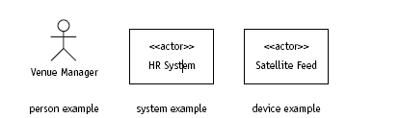
Actor guidelines
An actor is a person, organization, or external system that plays a role in one or more interactions with your system
An actor is a role, not necessarily a particular person or a specific system.
Same person can have many roles
Many people can have same role
Draw Actors To The Outside Of A Use Case Diagram
Name Actors With Singular, Business-Relevant Nouns
Associate Each Actor With One Or More Use Cases
Actors Model Roles, Not Positions
Actors Don’t Interact With One Another
Introduce an Actor Called “Time” to Initiate Scheduled Events

Slide 12
Relationships
There are 2 types of relationships that may appear on a use case diagram:
An association between an actor and a use case
An association between two use cases

Slide 13
Relationships guidelines
Indicate An Association Between An Actor And A Use Case If The Actor Appears Within The Use Case Logic
Avoid Arrowheads On Actor-Use Case Relationships
Apply <<includes>> When You Know Exactly When To Invoke The Use Case
Apply <<extends>> When A Use Case May Be Invoked Across Several Use Case Steps

Slide 14
Extra Relationships guidelines
Avoid More Than Two Levels Of Use Case Associations
Place An Included Use Case To The Right Of The Invoking Use Case
Place An Extending Use Case Below The Parent Use Case

Slide 15
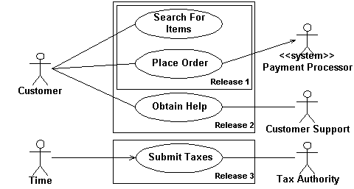
System Boundary Boxes
the system boundary box indicates the scope of your system
use cases inside the rectangle represent the functionality that you intend to implement.
Indicate Release Scope with a System Boundary Box
Avoid Meaningless System Boundary Boxes

Slide 16
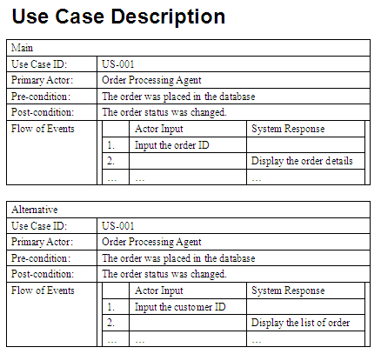
Use Case Description
Most Use Case descriptions include the following elements:
Use Case ID
Description
Actor involved
Pre-conditions
Process
Post-conditions
Can also include
Alternative flow
Non-functional requirements
Author
Last Updated Date

Slide 17
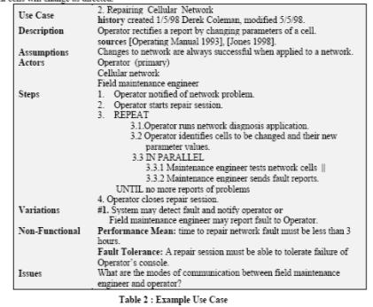
Use Case Description Example

Slide 18
Use Case Diagram: How to do it:
Identify the actors and their goals
Write the simple case: goal delivers
The main success scenario, the happy day case
Write failure conditions as extensions
Usually each step can fail
Follow the failure till it ends or rejoins
Recoverable extensions rejoin main course
Non-recoverable extensions fail directly
Note the deferred variations

Slide 19

UML and non-functional requirements
During analysis stage system analyst should collect both FUNCTIONAL and NON_FUNCTIONAL requirements
Use cases which are good for collecting functional requirements
Traditionally non-functional requirements are NOT captured by use cases or any other UML diagram. These include:
Security
Performance
Portability
Reliability
Usability
Accessibility

Slide 20
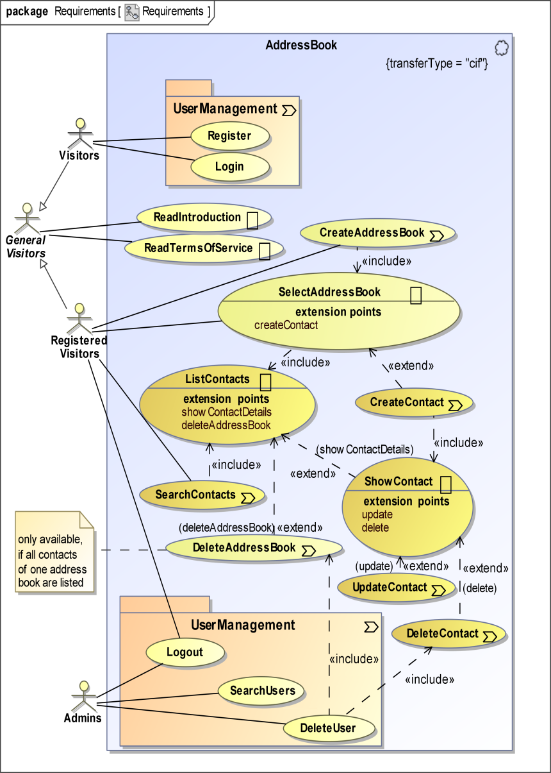
Use case model
Use Case Model consists of
One or more use case diagrams and
Supporting documentation such as use case specifications and actor definitions.
Use case models should be developed from the point of view of your project user and not from the (often technical) point of view of developers.

Slide 21
Reference List
[1] Venters W, 2008, Software engineering: theory and application: chapter 7, pp 56-58, LSE, University of London
[2] Fowler M, 2003, UML Distilled. A Brief Guide to Standard Object Modelling Language, Addison Wesley, 3rd edition
[3] Alister Cockburn, Use case fundamentals. Available from Online: http://alistair.cockburn.us/index.php/Use_case_fundamentals

Slide 22

End of Lesson
Any questions?

